Slide 1
Physics 201
Winter 2013
Vectors

Slide 2
Physical systems are always subject to multiple forces
Winter 2013
Dealing with forces is what vectors are for
We want to be able to “break apart” a force into specific separate components
We want to be able to “combine” multiple forces to determine their net effect
This is a subject known as “vector algebra”
  We will speak of “adding” vectors, but this is a metaphor: vectors are not numbers!

Slide 3
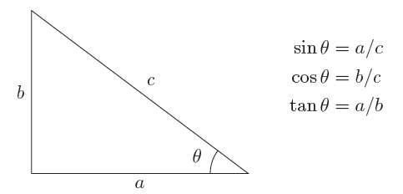
Vectors manage our use of trigonometry
Winter 2013
Behind every vector addition is a triangle – these are all essentially geometry problems
Trigonometry is the bridge between geometry and algebra – learn to love it

Slide 4
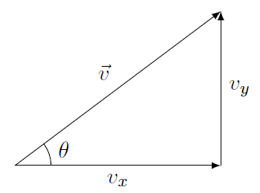

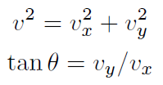
All you need to know about vectors: components
Winter 2013
Vector to components
Components to vector
Some fine print…
The arrow represents a vector, a letter without an arrow represents its magnitude
What I have drawn as components ought to be vectors, not magnitudes

Slide 5
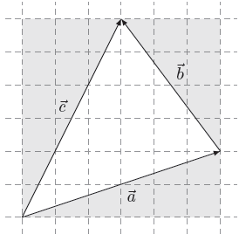

When you add vectors, add the components
Winter 2013
Every vector formula actually represents two or three component equations
If this makes your head hurt, imagine doing this without components…
Show me

Slide 6
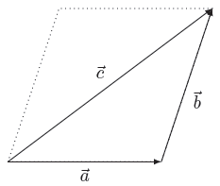
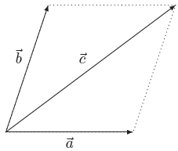
A subtle distinction…
Winter 2013
Displacement
Force
Consecutive addition
Align head-to-tail
Simultaneous addition
Align tail-to-tail
Show me

